Slide 1
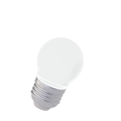
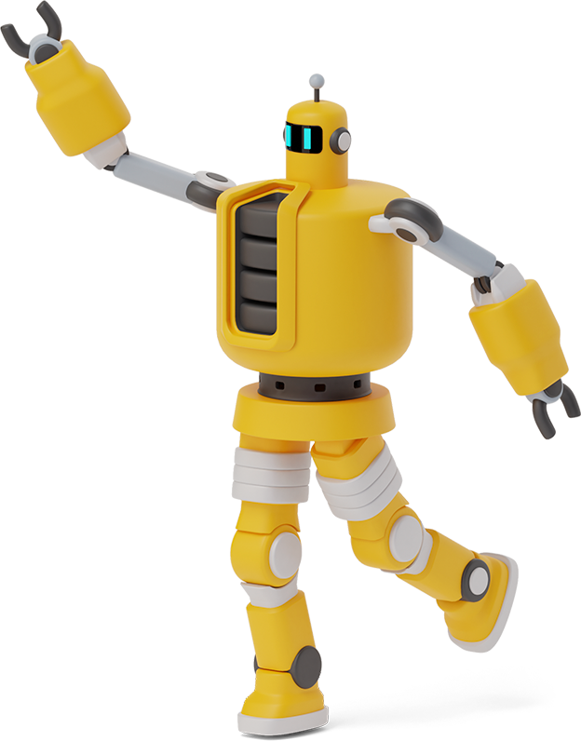
How i think living in future will look like

Slide 2
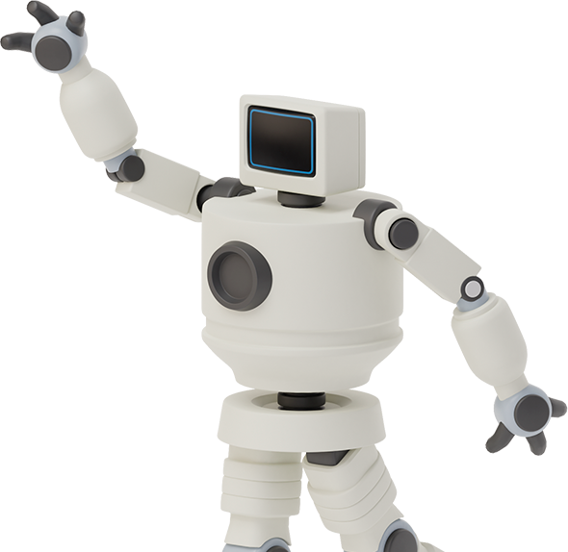
Living
People will live in very big cities. They will have huge houses with pools. Houses are going to be super modern with garrage in it. Also to every house they will have at least one flying car.The population still grows so people will ave to build big mracodraps BUT with microhotels. In every house will besuper srong wifi for studying and home office.

Slide 3
Our pets
You can choose robot pets or pets who are actualy alive. You can choose from three options:
Dogs
Cats
Hamsters
Pets will have special skafanders for travelling in space if you want to go on vacation with them.Also they will have their own small spaceships.

Slide 5
Thank you for attention

