Slide 1
Future of our nature

Slide 2
NATURE:
In future there will be the stroied nature.
There will be small quantity of trees.
On tourism you can go just in VR.
Air will be very dirty.
Protected plants will be just in National Parks.

Slide 3
ANIMALS:
The sea is going to be full of plasticks.
Animals are going to be protected.
The ZOO will be just in VR.
Turtles, dolphins and sharks won´t be allive.
Beach will be just on one planet.

Slide 4
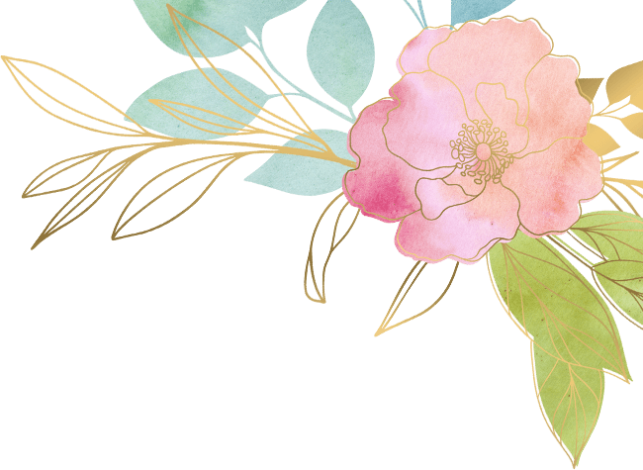
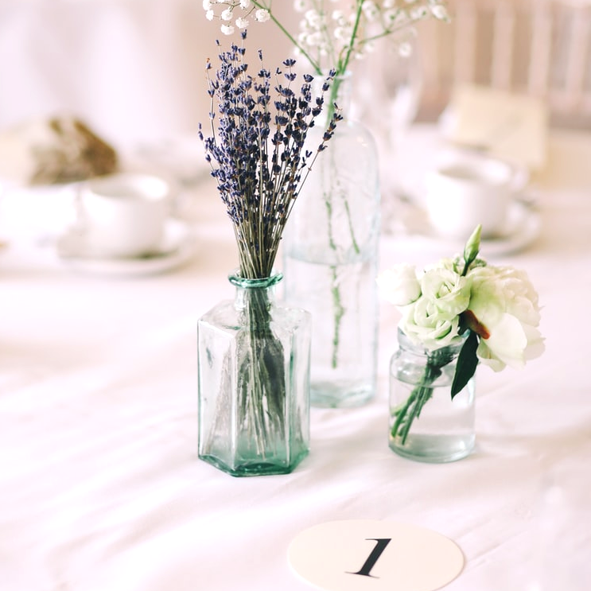
Thanks for
Watching!

