Slide 1
SCHOOL
In the future

Slide 2
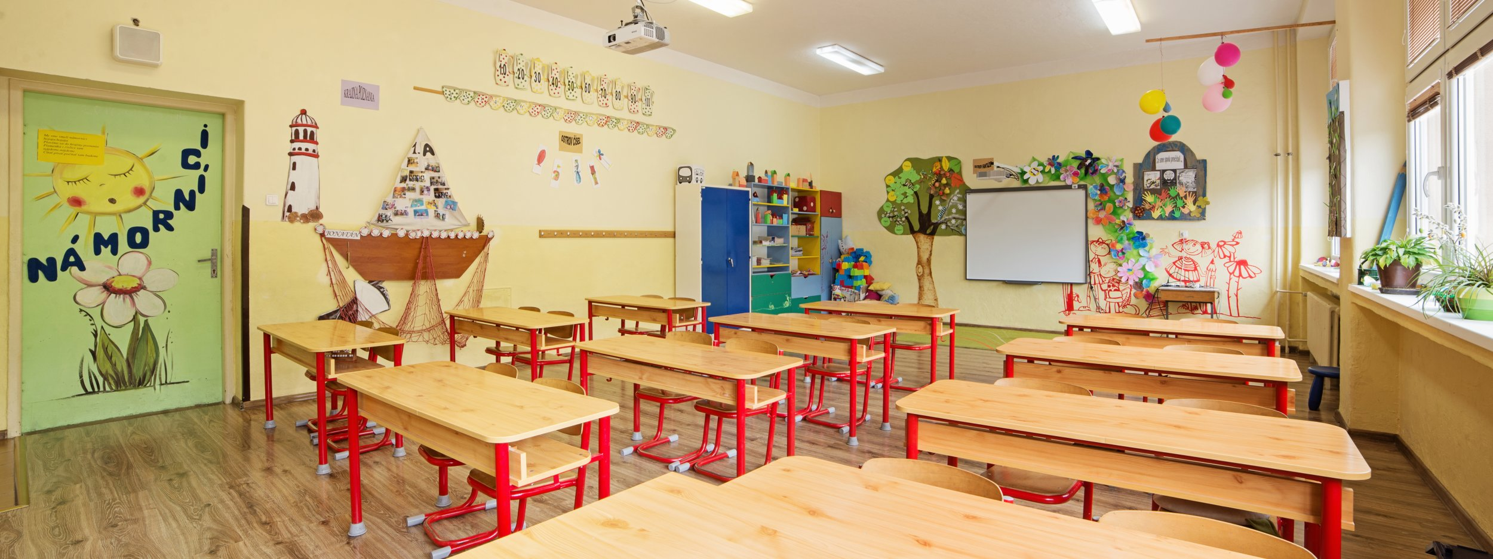
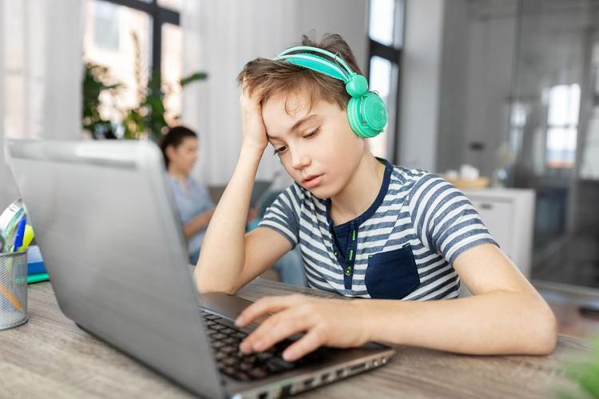
I THINK that online learning will be used in the future.
I hope children will not learn online.
children would will not learn anything.
I don't think robots will teach children Because it would
be too unnatural.
I think children will learn badly.
if online learning is the future, there will be digital textbooks.
paper books will not be used anymore.
I think that children will be only on the computer every day.
I would be happy if it wouldn‘t be so.

Slide 3
MY FUTURE
IN THE FUTURE, I WANT TO BE A DOCTOR.
I HOPE I WILL BECOME her.
IT MUST BE GREAT TO SAVE SO MANY PEOPLE EVERY DAY.
it will be difficult but I believe that I will overcome it.
I hope this big dream will comes true for me.

